Slide 1

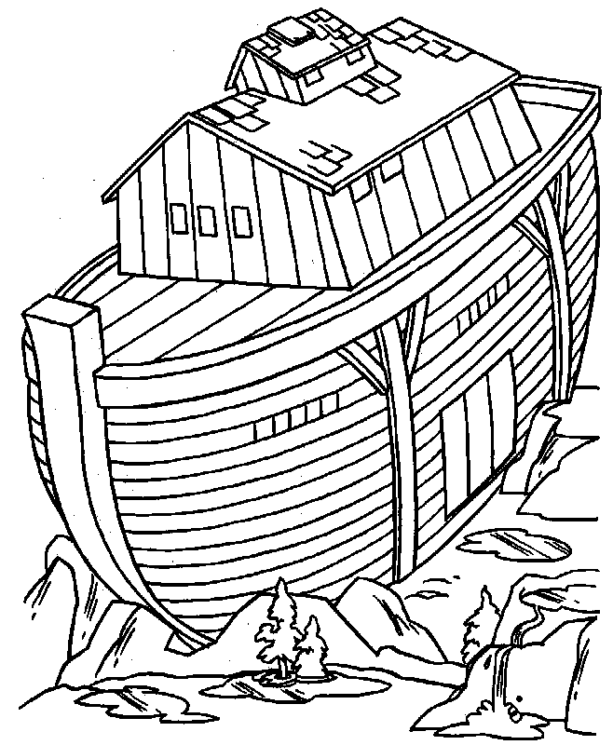
A tool to assist cohort projects.
Dr. Adrian Bickerstaffe
Centre for MEGA Epidemiology, UoM
All aboard!

Slide 2
Setting the scene
Types of epidemiology research:
New methodologies applied to data
Existing methodologies applied to data
Data is the heart of everything
Data is time-consuming to obtain
Good data is valuable
Data should be managed with state-of-the-art techniques

Slide 3
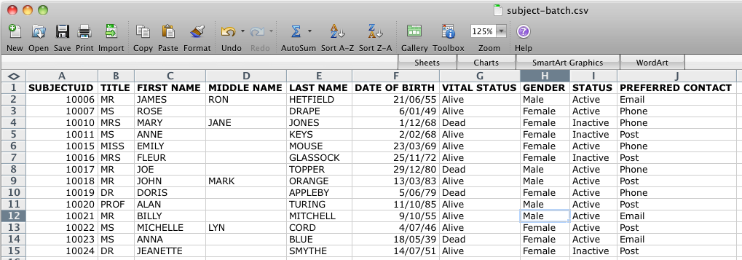
What doesn’t work
Spreadsheets

Slide 4
We need a database!
Database: a way to organize and structure data
Relational databases
Relations, tuples, attributes
Visualise as tables, rows, columns!
Structured Query Language (SQL)
INSERT, UPDATE, DELETE, SELECT
Examples:
Commercial: MS Access, MS SQL Server, Oracle
Open source: MySQL, PostgreSQL, SQLite

Slide 5
We need a database!
Columns, aka fields
ID | First name | Last name | Title_ID | Email
1 | Adrian | Bickerstaffe | 4 | adrianb@unimelb.edu.au
2 | Joe | Smith | 1 | joes@hotmail.com
3 | John | Bloggs | 5 | bloggo@gmail.com
4 | Wendy | Souza | 3 | souzaw@monash.edu.au
Rows,
aka records
ID | Title
1 | Mr
2 | Ms
3 | Mrs
4 | Dr
5 | Prof

Slide 6

Motivation for a new way
Grants, data types, primary keys, foreign keys, stored procedures, transactions, left joins, inner joins, normal forms…
Huh?

Slide 7
Motivation for a new way
INSERT INTO firstcancerdiagnosis
SELECT acddiagnoses.patref, mindate, icdcode, basis, histology, topography
FROM acddiagnoses INNER JOIN
(SELECT acddiagnoses.patref, MIN(date) AS mindate
FROM acddiagnoses
GROUP BY patref) AS first_diagnosis
ON first_diagnosis.mindate = acddiagnoses.date
AND first_diagnosis.patref=acddiagnoses.patref
GROUP BY patref;

Slide 8
A bit of history
In the beginning there was WAGER @ UWA GenEpi
2004 NHMRC Enabling Grant
Oracle database, Application Express
Study management, pheno, LIMS, data extraction
~50 studies hosted
Costs
Expertise
Licensing!

Slide 9
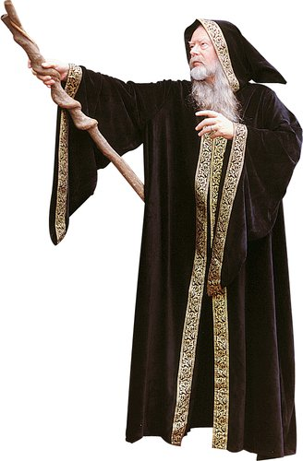
Open sourcery
The “new” Ark, 2009
To replicate the functionality of WAGER and more
To use only free open source software
A different business model
The software is free
Support/training/hosting is not free
GPL licensing
Encourage collaboration, protect openness

Slide 10


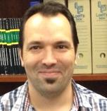
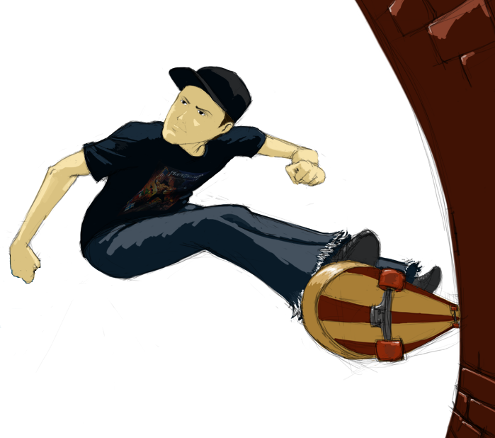
Meet the team
Noah – Paul White
Disciples of The Ark:
Chris Ellis
Travis Endersby
Adrian Bickerstaffe

Slide 11

A wish list
Four wishes:
Accessible
Secure
Flexible
Featureful

Slide 12
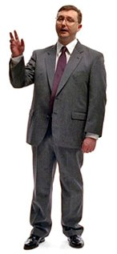
Wish #1 - accessibility
PC User

Slide 13
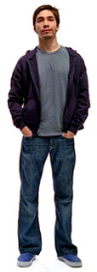
Wish #1 - accessibility
PC User
Mac User

Slide 14

Wish #1 - accessibility
Unix/
Unix-like
User
PC User
Mac User

Slide 15
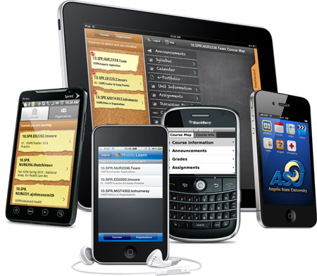
Wish #1 - accessibility
Unix/
Unix-like
User
PC User
Mac User

Slide 16

Wish #1 - accessibility
Unix/
Unix-like
User
PC User
Mac User

Slide 17
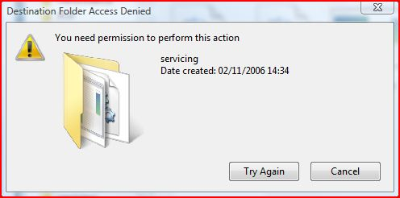
Wish #1 - accessibility
The Ark is accessible from any computer
No download/install is necessary
Updates are handled transparently

Slide 18
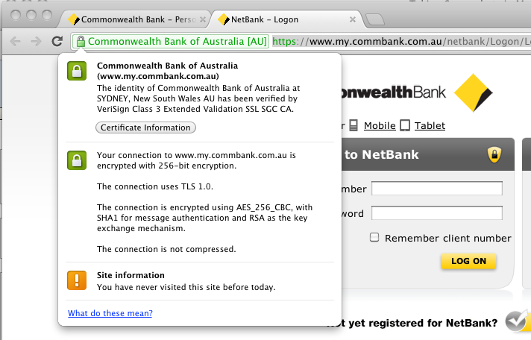
Wish #2 - security
System level security: digital certificates
1) Verify a site is what it claims to be
2) Facilitate encrypted communications with the host

Slide 19
Wish #2 - security
User level security
For each module (participant, pheno, LIMS, etc.):
Defined user roles
Administrator, data manager, read-only, no access
For each role, define access rights:
Create, read, update, delete (CRUD)
For each user:
Assign the user to a study
Set the user’s roles

Slide 20
Wish #3 - flexibility
One size fits most
One Ark instance - many different studies
Study components
Participant and biospecimen modules have a standard set of fields
What if your study needs other fields?

Slide 21
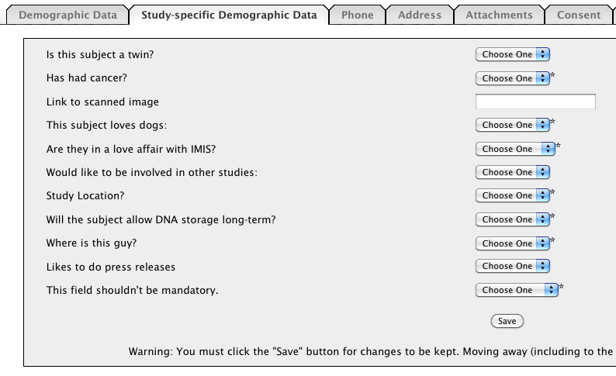
Wish #3 - flexibility
Custom fields to the rescue!
A custom field has:
A name
A type: date, numeric, character
Optionally:
Encodings
Units
Missing value
Validation rules

Slide 22
Wish #4 - featureful
To be useful, The Ark needs to manage:
Cohort participant data
Phenotype data
Biospecimen data
…and it needs to facilitate:
Data extraction
Reporting

Slide 23
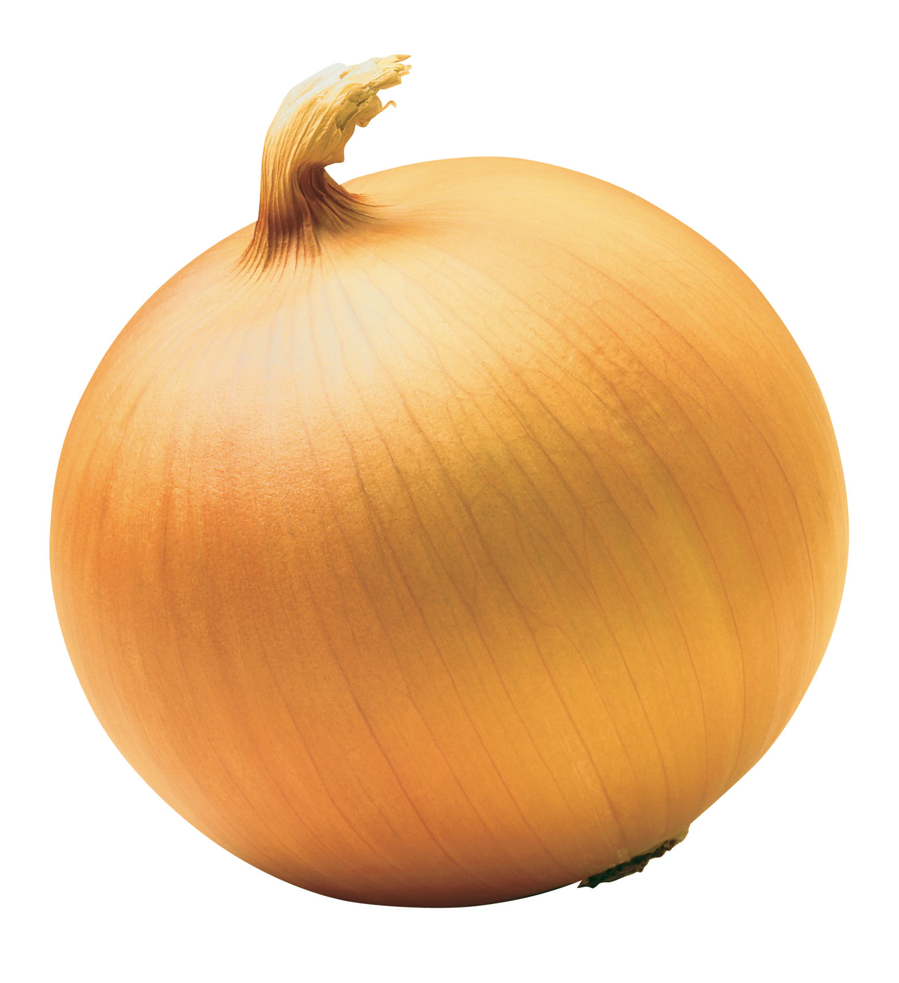
Software is like an onion

Slide 24
Software is like an onion
Security/authentication layer
(LDAP)
Shiro
Persistence layer
(database)
Service
layer
Presentation layer
(web)
Hibernate
Wicket

Slide 25
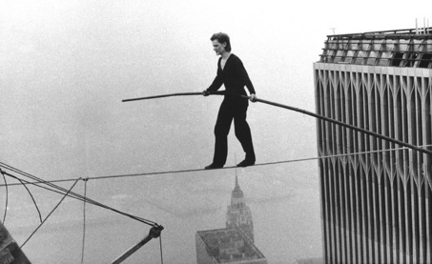
Time for a demo!
Funambulist: n., one who walks a tightrope

Slide 26
Participant module
A participant may belong to one or more studies
For each participant, we can record:
Basic demographic information
Consent with history
One-to-many:
Phone numbers and addresses
Correspondences
File attachments
Study components

Slide 27
Phenotype module
First, for each study, establish the data dictionary
Data dictionary: fields, data types, encodings, validation rules
Then define questionnaires as sets of data dictionary entries
Then enter questionnaire data and track questionnaire status

Slide 28
Biospecimen module
For each participant:
Collections
Date, comments
Collection custom fields
Biospecimens
Sample type, date, time, etc.
Collection
Barcode
Biospecimen custom fields

Slide 29
Biospecimen module
Inventory hierarchy:
Site
Site
Site
Freezer
Freezer
Rack
Rack
Box (row, column)
Box
Box
Box

Slide 30

Deployments in Australia
University of WA
Centre for Genetic Epidemiology and Biostatistics
Migrate WAGER-based studies to The Ark
University of Melbourne
Center for MEGA Epidemiology, hosting by NeCTAR NSP
lifepool
ATR, CCFR, etc.

Slide 31
Looking ahead
NeCTAR funding sufficient for 2 years
Design and implement modules for:
Data extraction
Reporting
Pedigrees
Genotypic data
Registries
Host more projects!

Slide 32
The “take home” message
The Ark, B.C.
A place to keep valuable and useful things.

Slide 33
The “take home” message
The Ark, B.C.
A place to keep valuable and useful things.
The Ark, 2012A.D.
A place to keep valuable and useful things.

Slide 34
Limesurvey
Develop and deploy online questionnaires
Open source and free
Reduce the costs and labour involved with paper questionnaire processing

Slide 35
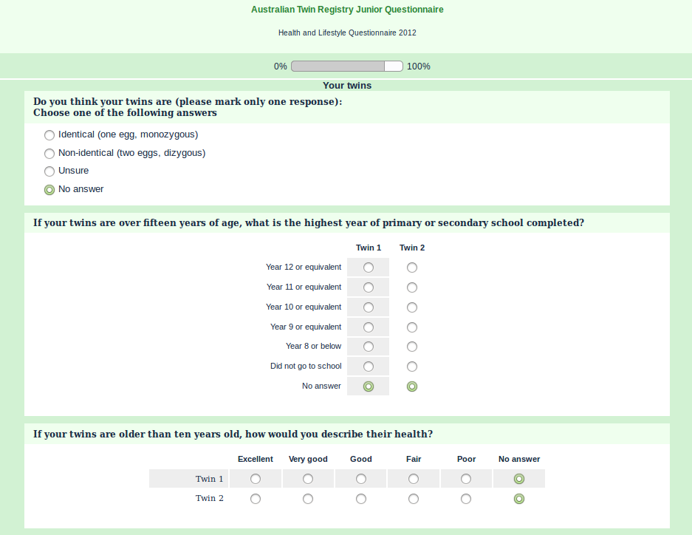

Slide 36
Limesurvey
You need:
A web server with some plugins
A MySQL database server
An email server
Design survey via the web front-end
Pagination, skip logic, validations
Import recipient names, email addresses, etc.
Batch send invites and track responses

